Slide 1
Promit Biswas
1810039

Slide 2
Topic
Connotation
vs
Denotation

Slide 3
Is there more to a word than how it is defined in the dictionary?

Slide 4
Yes, there is more. In fact, every word has at least two meaning sets:
Connotative and Denotative

Slide 5

CONNOTATION
The connotation is based on the figurative or emotional meaning of a word, which includes personal and cultural associations the reader/writer may have with the word.
Modern Portfolio Designed

Slide 6
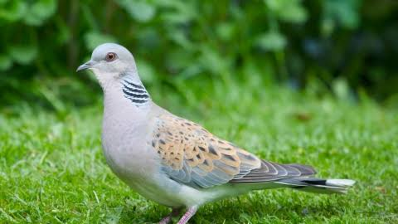
CONNOTATION
Dove
Connotation=Peace, Love
Let the key word is dove.
Dictionary meaning = A small bird.
But for many people there is a connotation of peace.
Because doves are often chosen as the symbol of peace.

Slide 7
Types of CONNOTATION
Scrawny , Scared, Cheap
Negative Connotation
Bold , Stylish ,Brave, Inexpensive
Positive Connotation

Slide 8
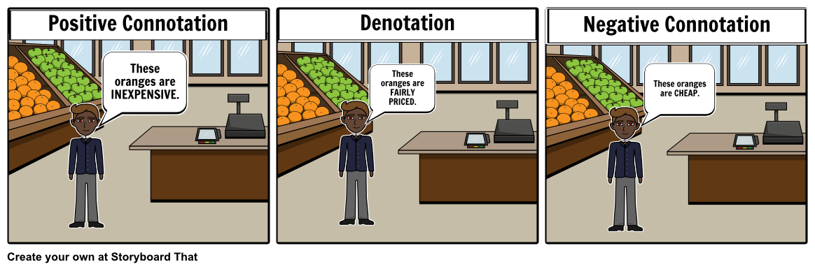
Connotation Types
Positive Connotation
Thinking Positively.
Negative Connotation
Thinking Negatively

Slide 9
DENOTATION
The denotation is based on the literal dictionary definition of a word.
Modern Portfolio Designed

Slide 10
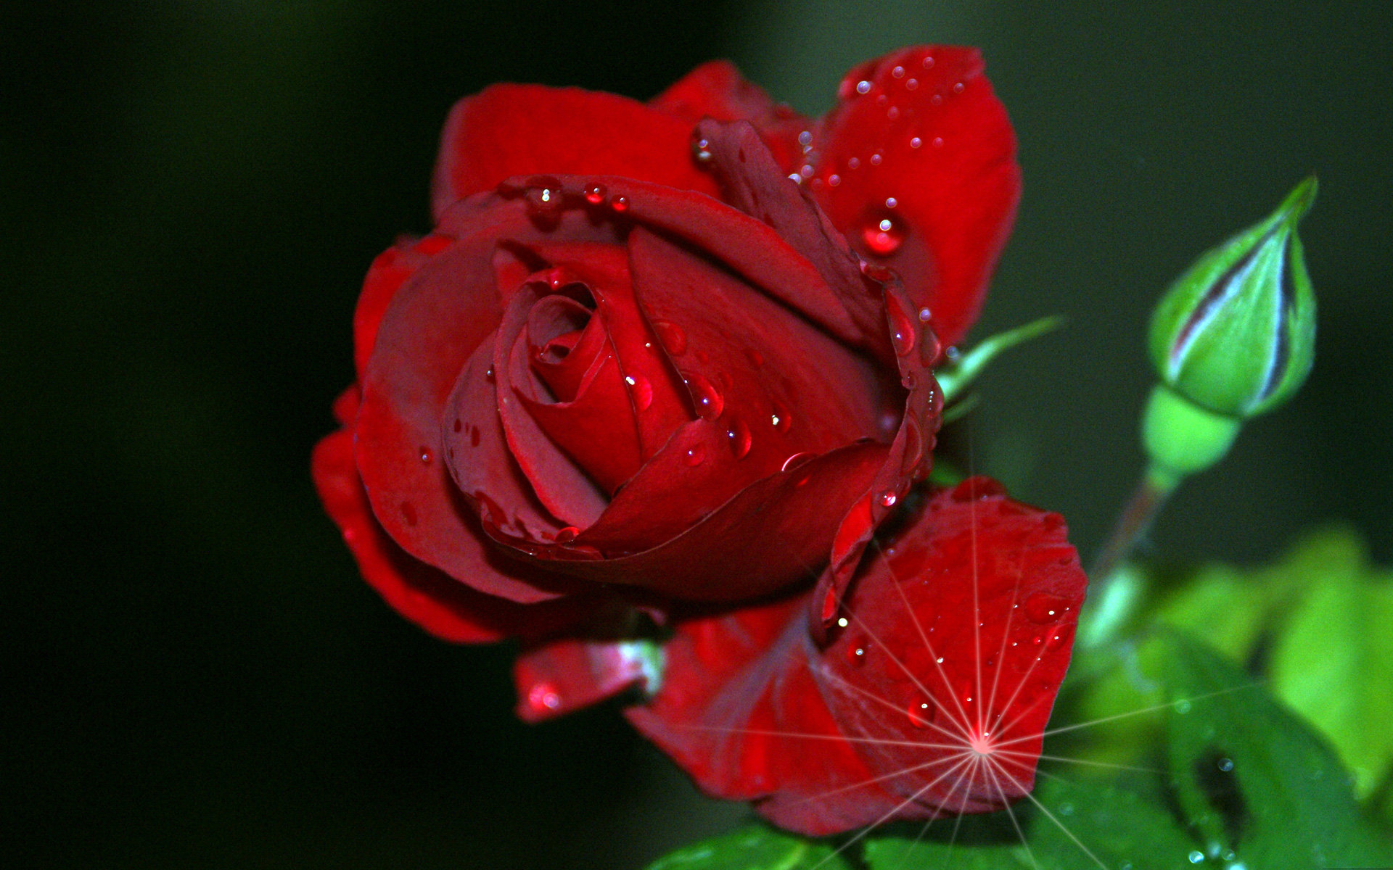
DENOTATION
We can call it =ROSE
About Picture
What the picture denotes is a flower with a sweet smell that grows on a bush with thrones on it’s steam

Slide 11
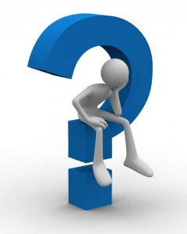
So, What’s the difference?
Connotation VS Denotation

Slide 12
Those are→
Connotation
Denotation
1. Connotation is an emotional input attached to a word thus making it more figurative or suggestive.
1. Denotation is the actual literal definition or meaning of a word or term.
2. Connotation have can have a variety of description affected by mood, emtion, experience, season, etc.
2. Denotation gives a more limited yet descriptive definition of a word.

